Slide 1

Bangladesh Army University of Science and Technology
Department of Computer Science And Engineering
Course Title: Database Management System Sessional
Course Code: CSE 2206
Project: Smart City Transport Management System
Submitted By
Submitted To
Md. Al-Maynul Hasan -0802420205101025
Md. Asif Hasan - 0802420205101032
Md. Maruf Siddiki - 0802420205101034
AKZ Rasel Rahman, Lecturer S.M Golam Rifat, Lecturers

Slide 2
TABLE OF CONTENTS
01
Introduction
06
Ticket Exchange Feature
Background & Objectives
Marketplace deep-dive
02
Key Features
07
Limitations
Core system capabilities
Known constraints
03
Tech Stack & Architecture
08
Future Work
Tools, languages & system design
Planned enhancements
04
Database Design
09
Conclusion
Schema & API overview
Summary & takeaways
05
Demo & Screenshots
Live UI walkthrough

Slide 3
INTRODUCTION
About SCTMS
Context
SCTMS (Smart City Transport Management System) is a full-stack web application designed to digitize and streamline urban transport ticket booking in Bangladesh.
Passengers can search routes, select seats, make payments, manage their bookings, and even exchange tickets with other passengers all from a single platform.
Domain:
Urban Public Transport
Region:
Bangladesh
Type:
Web Application
Frontend:
HTML · CSS · JS
Objectives
Backend:
Node.js · Express
Eliminate manual/paper-based ticket counters
Provide real-time seat availability
Enable secure online payments
Allow peer-to-peer ticket transfers
Database:
MS SQL Server
Auth:
JWT Tokens

Slide 4






KEY FEATURES
Route & Schedule Search
Seat Map & Multi-Seat Booking
OTP Payment Flow
Real-time route and schedule lookup across all available trips
Visual seat layout with per-seat individual booking IDs
Demo payment simulation with OTP verification
Ticket Exchange Marketplace
Waitlist & Notifications
Admin Dashboard
Sell or swap individual seats P2P without cancelling others
Auto-queue system when seats are full; alerts on availability
User management, promo codes, analytics & booking oversight

Slide 5




TECH STACK & SYSTEM ARCHITECTURE
Technology Stack
System Architecture (3-Tier)
Frontend
Presentation Tier
HTML5 · CSS3 · Vanilla JavaScript
HTML/CSS/JS Pages
Browser (Live Server)
Backend
▼
Node.js · Express.js (REST API)
Application Tier
Node.js + Express
REST API + JWT Auth
Database
Microsoft SQL Server (SSMS)
▼
Data Tier
Auth
MS SQL Server
SCTMS Database
JWT — JSON Web Tokens (7-day expiry)

Slide 6
DATABASE DESIGN & API OVERVIEW
Core Database Tables
REST API Endpoints
Base: http://localhost:5000/api
Users
UserID · Name · Email · Password · Role
POST
/auth/register & /login
Routes
RouteID · Source · Destination · Duration
GET
/schedules/search
Schedules
ScheduleID · RouteID · DepartureTime · SeatsTotal
POST
/bookings
Bookings
BookingID · UserID · ScheduleID · SeatNo · Status
PUT
/bookings/:id/cancel
Payments
PaymentID · BookingID · Amount · OTP · Status
GET
/transfer/marketplace
TicketTransfers
TransferID · BookingID · ListType · NewOwnerID
POST
/transfer/list-swap
Notifications
NotifID · UserID · Message · IsRead
GET
/admin/users

Slide 7
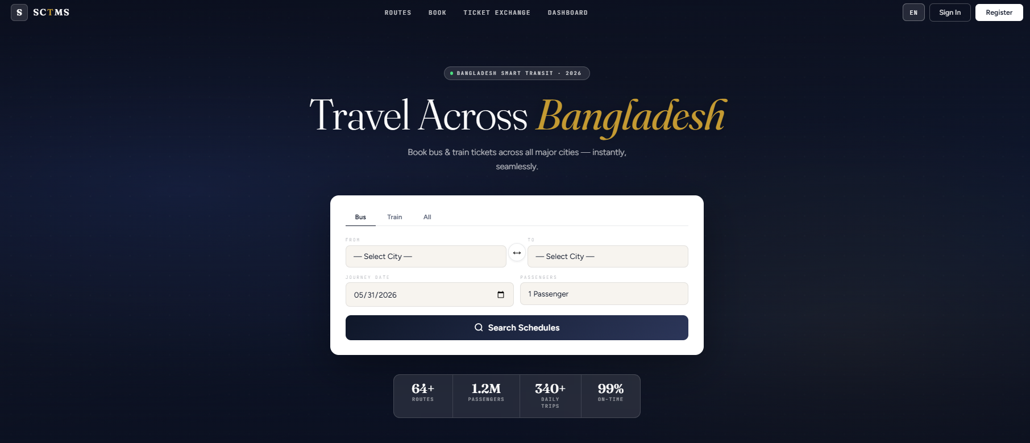
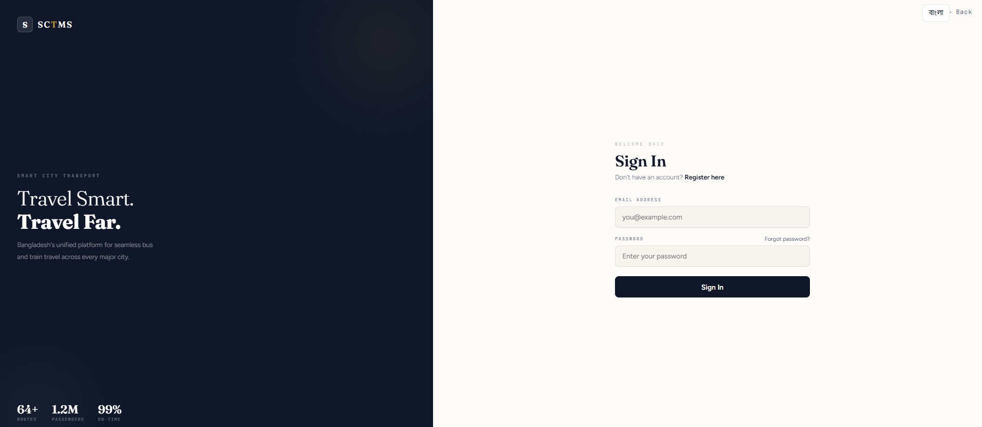
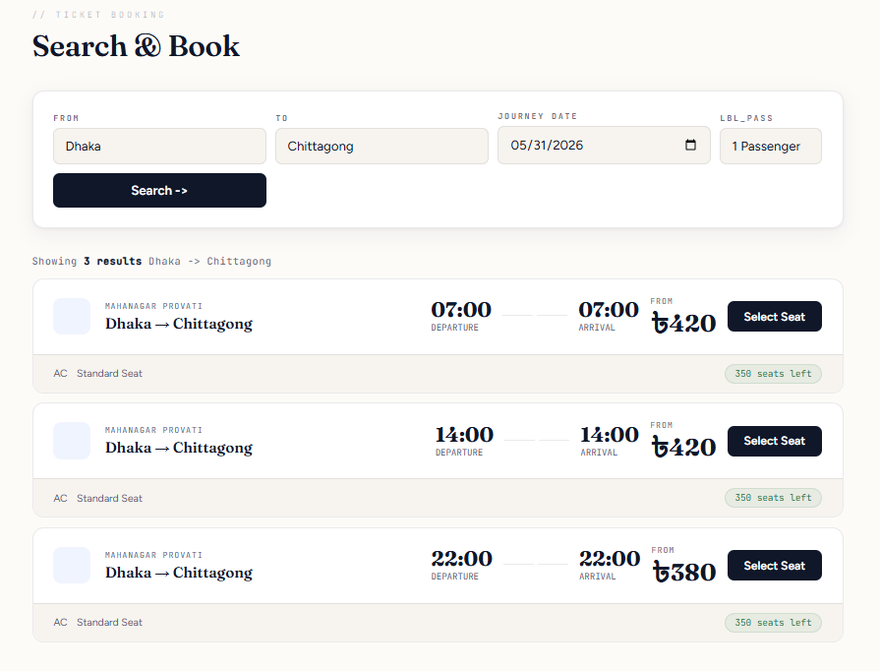
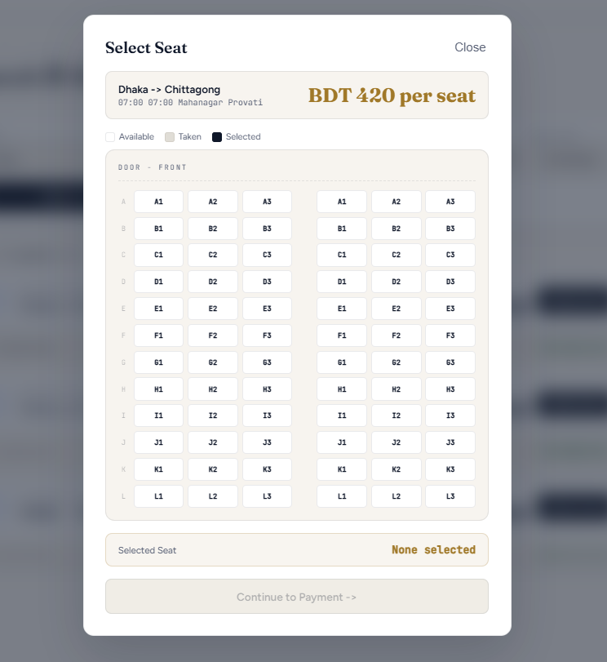
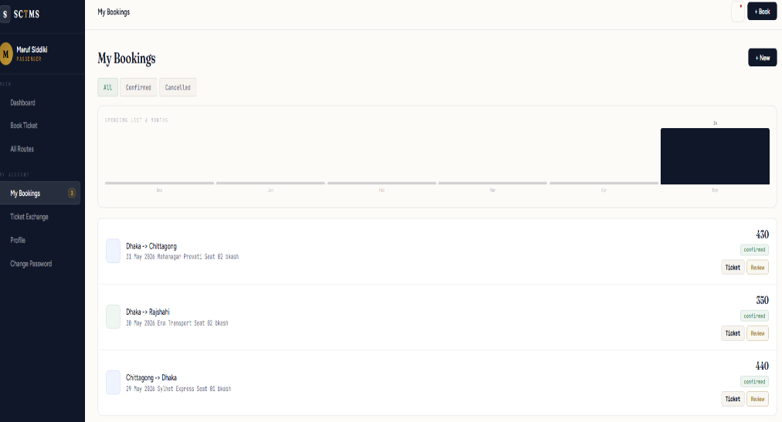
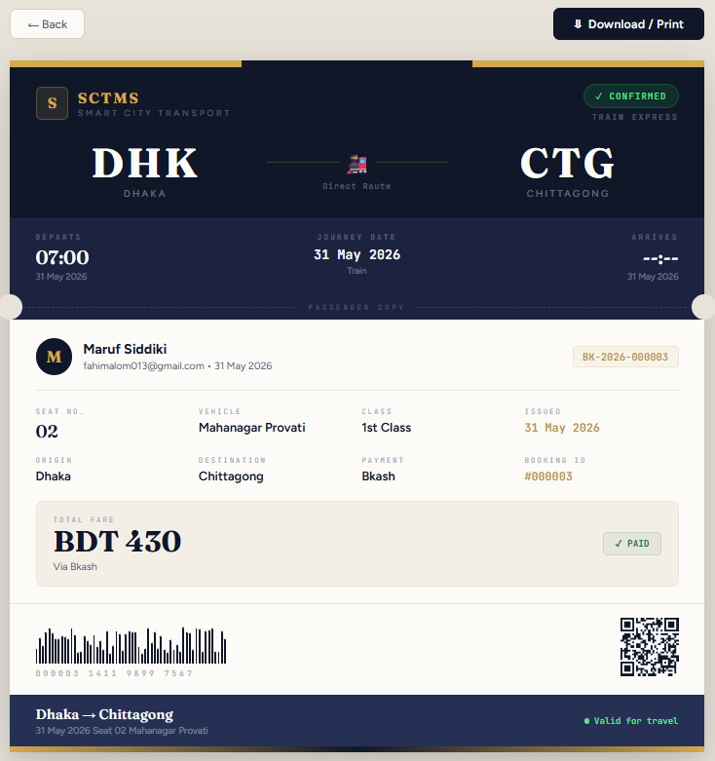
DEMO & SCREENSHOTS
Figure 1: Homepage Interface
Figure 2: Login Interface
Figure 3: Ticket Booking Interface
Figure 4: View Ticket Interface

Slide 8
TICKET EXCHANGE MARKETPLACE
Unique Feature: Per-seat booking IDs allow individual ticket transfers without affecting other seats.
1
2
3
4
Multi-Seat
Booking
List for
Sale/Swap
Another
Passenger
Transfer
Confirmed
→
→
→
Passenger books
Seat 01 → #27
Seat 02 → #28
Only Booking #27
listed on marketplace
Buyer finds &
requests the ticket
#27 → new owner
#28 stays unchanged
💡 Key Insight: Booking #28 (Seat 02) remains CONFIRMED and unaffected by the transfer of Booking #27.

Slide 9

LIMITATIONS
Demo Payment Only
No Mobile App
The payment flow uses OTP simulation — no real payment gateway (e.g. bKash, SSL Commerz) is integrated.
Currently only a browser-based web application. No native Android or iOS app exists.
Local Database
No Real-time Updates
Uses MS SQL Server Express locally. Not deployed on cloud (no Azure, AWS, or cloud DB).
Seat availability and notifications are not pushed in real-time (no WebSocket or polling).
Email/SMS Notifications
Single Admin Role
Notification system is database-driven only — no actual email or SMS is sent to users.
No role hierarchy — all admin users have full access; no support for operator-level or moderator roles.

Slide 10



FUTURE WORK
Real Payment Gateway
Mobile Application
Cloud Deployment
Integrate bKash, Nagad, or SSL Commerz for live transactions
Develop native Android/iOS app using React Native or Flutter
Host backend on AWS/Azure; migrate DB to cloud SQL Server
Real-time Notifications
Analytics Dashboard
GPS Route Tracking
Implement WebSockets for live seat updates and push alerts
Revenue charts, peak-hour heatmaps for transport operators
Live vehicle tracking and estimated arrival time for passengers

Slide 11
Conclusion
The Smart City Transport Management System (SCTMS) successfully provides a secure, efficient, and user-friendly solution for transport management. By integrating database technologies, authentication, automated booking, and administrative controls, the system ensures reliable service and data integrity. Overall, the project demonstrates how modern database-driven applications can improve transportation services while offering scalability for future enhancements.

Slide 12
SCTMS
Smart City Transport Management System
Thank You

